Slide 1
CS2009 Design and Analysis of Algorithm
Week-3b
Dr. Usman Ghous

Slide 2
Recurrence Relations

Slide 3
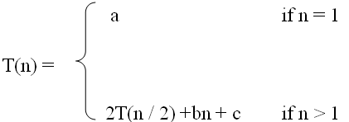

What is a recurrence relation?
A recurrence relation, T(n), is a recursive function of integer variable n.
Like all recursive functions, it has both recursive case and base case.
Example:
The portion of the definition that does not contain T is called the base case of the recurrence relation
The part that contains T is called the recurrent or recursive case.

Slide 4

Forming Recurrence Relations
For a given recursive method, the base case and the recursive case of its recurrence relation correspond directly to the base case and the recursive case of the method.
Example 1: Write the recurrence relation for the following method.
The base case is reached when n == 0. The method performs one comparison. Thus, the number of operations when n == 0, T(0), is some constant a.
When n > 0, the method performs two basic operations and then calls itself, using ONE recursive call, with a parameter n – 1.
Therefore the recurrence relation is:
public void f (int n) {
if (n > 0) {
System.out.println(n);
f(n-1);
}
}

Slide 5

Forming Recurrence Relations
Example 2: Write the recurrence relation for the following method.
The base case is reached when n == 1. The method performs one comparison and one return statement. Therefore, T(1), is constant c.
When n > 1, the method performs TWO recursive calls, each with the parameter n / 2, and some constant # of basic operations.
Hence, the recurrence relation is:
public int g(int n) {
if (n == 1)
return 2;
else
return 3 * g(n / 2) + g( n / 2) + 5;
}

Slide 6
Solving Recurrence Relations
Methods to solve recurrence relations that represent the running time of recursive methods:
Iteration method (unrolling and summing)
Recursion tree method
Master method

Slide 7
Iteration Method

Slide 8
Iteration Method
Back Substitution method
unrolling and summing
Iteration consist of repeatedly substituting the recurrence into itself to obtain an summation expression

Slide 9
Analysis Of Recursive Factorial method
Example: Form and solve the recurrence relation for the running time of factorial method and hence determine its big-O complexity:
T(0) = c
T(n) = b + T(n - 1)
= b + b + T(n - 2)
= b +b +b + T(n - 3)
…
= kb + T(n - k)
When n-k = 0, we have: n=k
T(n) = nb + T(n - n)
= bn + T(0)
= bn + c.
Therefore method factorial is O(n).
long factorial (int n) {
if (n == 0)
return 1;
else
return n * factorial (n – 1);
}

Slide 10
Analysis Of Recursive Binary Search
public int binarySearch (int target, int[] array,
int low, int high) {
if (low > high)
return -1;
else {
int middle = (low + high)/2;
if (array[middle] == target)
return middle;
else if(array[middle] < target)
return binarySearch(target, array, middle + 1, high);
else
return binarySearch(target, array, low, middle - 1);
}
}
The recurrence relation for the running time of the method is:
T(1) = a if n = 1 (one element array)
T(n) = T(n / 2) + b if n > 1
Notes:
Low > high
Will true when index reaches out of bound from any side ledt or right

Slide 11
Analysis Of Recursive Binary Search
Expanding:
T(n) = T(n / 2) + b
= [T(n / 4) + b] + b = T (n / 2²) + 2b
= [T(n / 8) + b] + 2b = T(n / 2³) + 3b
= ……..
= T( n / 2^{k}) + kb
When n / 2^{k} = 1 ➔ n = 2^{k} ➔ k = log n, we have:
T(n) = T(1) + b log n
= a + b log n
Therefore, Recursive Binary Search is O(log n)

Slide 12
Home Work
T(n) = T(n-1) + bn
T(0) = c
Notes:
Algorithm Test(n)
if n= 0
then return;
else
For i := 1 to n do
C[1] := A[1] * B[i];
Test(n-1);

Slide 13
Solution
T(n) = T(n-1) + bn
= (T(n-2) + b(n-1)) + bn
= T(n-3) + b(n-2)) +b(n-1) + b(n)
= T(n-4) + b(n-3)+ b(n-2)) +b(n-1) + b(n)
= T(n-4) + b[(n-3)+ (n-2) +(n-1) + n]
Generalizing this to k would give us
= T(n-k) + b[(n-k+1)+... +(n-3)+ (n-2) +(n-1) + n]
= T(n-k) +b. k(k-1)/2
n-k=0 => n=k
= T(0)+b[(n-1)(n)/2]
=c+ b[(n-1)(n)/2] = c+bn^2/2+bn/2
=O(n^2)
Notes:
K2 +1 -2k

Slide 14
Recursion Tree Method

Slide 15
Recursion tree method
solving recurrences
expanding the recurrence into a tree
summing the cost at each level
Difference between depth and height of node
Notes:
Number of nodes at some level?
The height of a tree is equal to the max depth of a tree.
The depth of a node is the number of edges from the node to the tree's root node. A root node will have a depth of 0.
The height of a node is the number of edges on the longest path from the node to a leaf. A leaf node will have a height of 0.

Slide 16
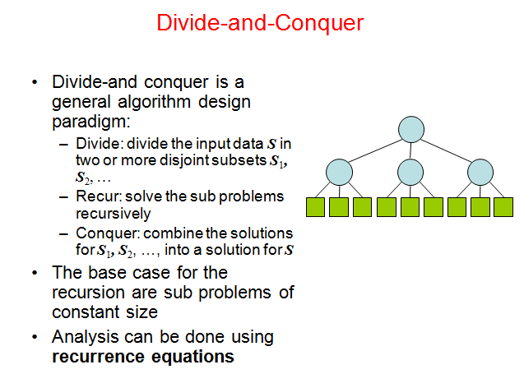

Slide 17
Recursion tree
Solve T(n) = 2T(n/2) + c n, where c > 0 is constant.
T(n)
Here Tree nodes represent costs incurred at various levels of the recursion

Slide 18
Recursion tree
Solve T(n) = 2T(n/2) + cn, where c > 0 is constant.
cn
T(n/2)
T(n/2)

Slide 19
Recursion tree
Solve T(n) = 2T(n/2) + cn, where c > 0 is constant.
cn
cn/2
cn/2
T(n/4)
T(n/4)
T(n/4)
T(n/4)

Slide 20
Recursion tree
Solve T(n) = 2T(n/2) + cn, where c > 0 is constant.
cn
cn/2
cn/2
cn/4
cn/4
cn/4
cn/4
…
Ο(1)

Slide 21
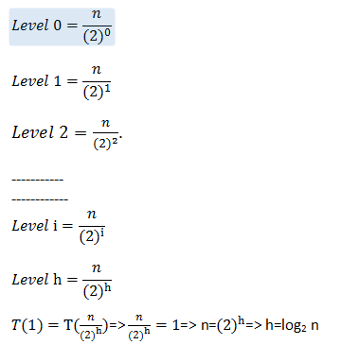
Determining depth/height of tree

Slide 22
Recursion tree
Solve T(n) = 2T(n/2) + cn, where c > 0 is constant.
cn
cn/2
cn/2
h = log n
cn/4
cn/4
cn/4
cn/4
…
Ο(1)

Slide 23
Recursion tree
Solve T(n) = 2T(n/2) + cn, where c > 0 is constant.
cn
cn
cn/2
cn/2
h = log n
cn/4
cn/4
cn/4
cn/4
…
Ο(1)

Slide 24
Recursion tree
Solve T(n) = 2T(n/2) + cn, where c > 0 is constant.
cn
cn
cn/2
cn/2
cn
h = log n
cn/4
cn/4
cn/4
cn/4
…
Ο(1)

Slide 25
Recursion tree
Solve T(n) = 2T(n/2) + cn, where c > 0 is constant.
cn
cn
cn/2
cn/2
cn
h = log n
cn/4
cn/4
cn/4
cn/4
cn
…
…
Ο(1)

Slide 26
Recursion tree
Solve T(n) = 2T(n/2) + cn, where c > 0 is constant.
cn
cn
cn/2
cn/2
cn
h = log n
cn/4
cn/4
cn/4
cn/4
cn
…
…
Ο(1)
#leaves = n
Ο(n)

Slide 27
Recursion tree
Solve T(n) = 2T(n/2) + cn, where c > 0 is constant.
cn
cn
cn/2
cn/2
cn
h = log n
cn/4
cn/4
cn/4
cn/4
cn
…
…
Ο(1)
#leaves = n
Ο(n)
Total = Ο(n log n)
Notes:
Level 0=cn
Level 1=cn/2^1
Level2=cn/2^2
Level i=cn/2^i
Level h=cn/2^h
T(n/2^h)=T(1)
H=logn

Slide 28
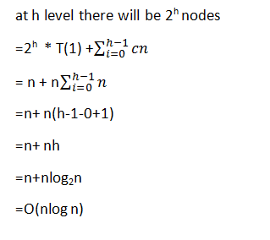
Notes:
2()log base 2

Slide 29

T(n) = T(n/3) + T(2n/3) + n. T(1) = 1 Solve it by recursion tree method

Slide 30
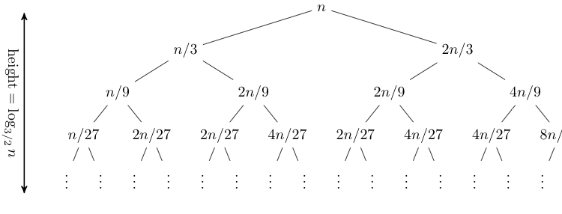
T(n) = T(n/3) + T(2n/3) + n, T(1) = 1
T(n) = T(n/3) + T(2n/3) + n.
T(1) = 1
Expanding out the first few levels, the recurrence tree is:
the closed form of this recurrence is O(n log n).
Notes:
Level 0=n
Level 1=n(2/3)^1
Level2=n(2/3)^2
Level i=n(2/3)^i
Level h=n(2/3)^h
T(2/3)^h=T(1)

Slide 31
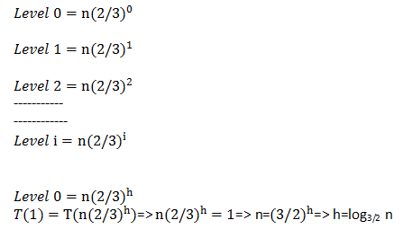
Determining Height of tree
Notes:
http://www.cs.ucr.edu/~jiang/cs141/recur-tut.txt

Slide 32
Home Task: Do it yourself
Solve T(n) = 3T(n/4) + cn²,
where c > 0 is constant.
Notes:
Tree on board

Slide 33
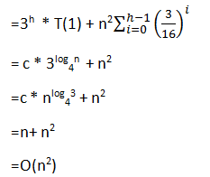
Notes:
T(n) = 3T(n/4) + cn²

Slide 34
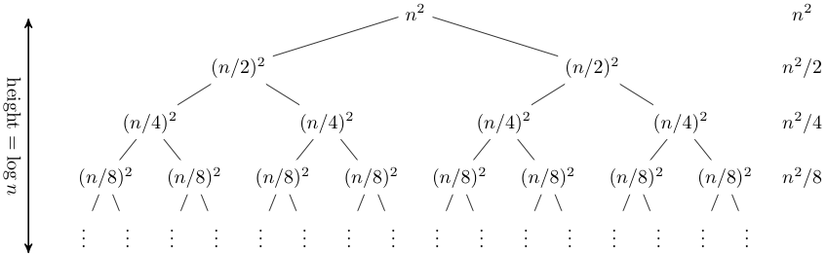
Home Task: Do it yourself
Solve T(n) = 2T(n/2) + n²

Slide 35
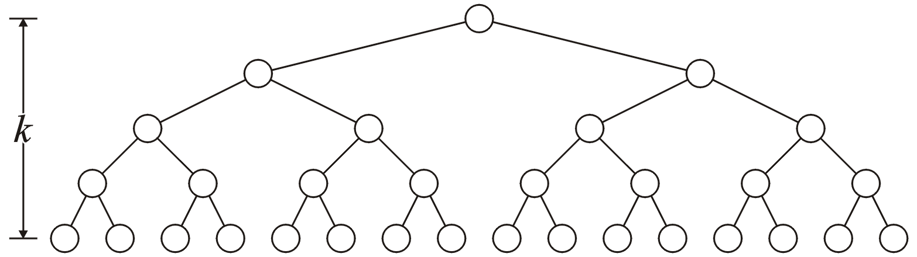
Binary Tree
A perfect binary tree with height h has 2^{h} leaf nodes
A perfect binary tree of height h has 2^{h + 1} – 1 nodes
Number of leaf nodes: L = 2^{h} ,and with n branch factor = n^{h}
Number of internal nodes: 2^{h} – 1
Total number of nodes: 2L-1 = 2^{h + 1} – 1
h

Slide 37
When not to use
You cannot use the Master Theorem if
T(n) is not monotone, e.g. T(n) = sin(x), x^3
f(n) is not a polynomial, e.g., T(n)=2T(n/2)+2^n
b cannot be expressed as a constant.

Slide 38
Why to use
measure of algorithm efficiency
has a big impact on running time.
Big-O notation is used.
To deal with n items, time complexity can be O(1), O(log n), O(n), O(n log n), O(n²), O(n³), O(2^{n}), even O(n^{n}).

Slide 39
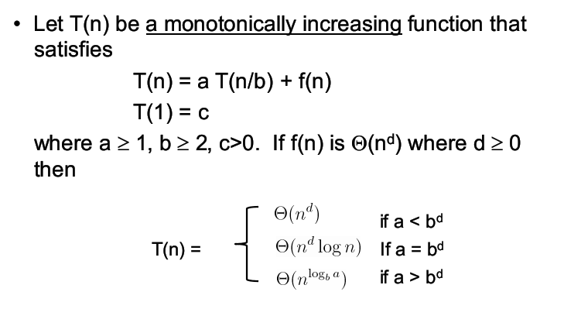
Master Theorem Simplest version

Slide 40
Master Theorem Updated
The Master Theorem applies to recurrences of the following form:
T (n) = aT (n/b) + f (n)
where a ≥ 1 and b > 1 and k ≥ 0 and p can be any real number and f (n) is an asymptotically positive function and f(n) = Θ(n^{k} log^{p} n). There are 3 cases:
If a > b^{k} , then T (n) = Θ(n^{logb a}).
If a = b^{k} , then
If p > -1 then T (n) = Θ(n^{logb a} log^{p+1} n).
If p = -1 then T (n) = Θ(n^{logb a} loglog n).
If P < -1 then T (n) = Θ(n^{logb a}).
If a < b^{k} , then
If p ≥ 0, then T (n) = Θ(n^{k} log^{p} n).
If p < 0 then T (n) = Θ(n^{k}).

Slide 41
Case – 1 If a > b^{k} , then T (n) = Θ(n^{logb a}).
T (n) = 4T (n/2) + n
a= 4>1
b= 2>1
k = 1>0
p = 0 that is a real number
If a > b^{k} , then T (n) = Θ(n^{logb a}).
4 > 2¹ then T(n) = Θ(n^{log2 4}) = Θ(n²)

Slide 42
Case – 2 If a = b^{k} , then If p > -1 then T (n) = Θ(n^{logb a} log^{p+1} n). If p = -1 then T (n) = Θ(n^{logb a} loglog n). If P < -1 then T (n) = Θ(n^{logb a}).
T (n) = 2T (n/2) + nlogn
T (n) = 2T (n/2) + n/logn
T (n) = 2T (n/2) + n/ log²n

Slide 43
Case – 3 If a < b^{k} , then If p ≥ 0, then T (n) = Θ(n^{k} log^{p} n). If p < 0 then T (n) = Θ(n^{k}).
T (n) = 2T (n/2) + n²
T (n) = 3T (n/2) + n²/logn

Slide 44
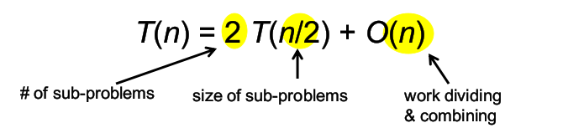
Time Complexity of merge sort

Slide 45
Problems
T (n) = 3T (n/2)+ n^2
T (n) = 4T (n/2)+ n^2
T (n) = 2T (n/2)+ n log n
T (n) = 3T (n/2)+ n
T (n) = 6T (n/3) + n² log n
T (n) = Θ(n2 log n) (Case ?)
T (n) = 4T (n/2) + n/ log n
T (n) = Θ(n^2) (Case ?)
T (n) = Θ(n^2 log n) (Case ?)
T (n) = n log^2 n (Case ?)
T (n) = Θ(n^lg 3) (Case ?)
T (n) = Θ(n²) (Case ?)
Notes:
a<bk = case 3

